Slide 1
Bathroom Overdose Alert System
Carly Loy, Elizabeth Wig, Toyin Yusuf, Zahava Hirsch, Ziwen Xie

Slide 2
The Problem
The Goal
High prevalence of overdoses in hospital bathrooms
In a busy ER it can take nurses a while to realize that someone has been in the bathroom for a while
By the time the nurses/physicians notice it could be too late
Decrease the time between overdose and discovery so that Narcan can be used as quickly as possible
Narcan takes 6 minutes to take effect, so time is of the essence!

Slide 3
The Solution
We created a dual sensory alert prototype that can be used with a bathroom’s light motion sensor. This prototype is installed into a bathrooms lock mechanism and can be incorporated into any hospital’s alert system eg: EPIC, pagers, nursing station alarm
Using a light sensor and force sensor, this prototype will send out an alert when
The bathroom door is locked AND
The bathroom light has been off for more than 15 seconds (time can be modified)

Slide 4
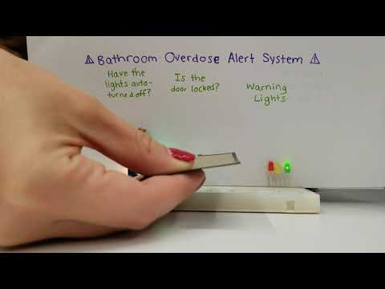
Demonstration
Notes:
Toyin

Slide 5
Benefits
Faster medical response to overdoses
Lives saved
Frees nurses from constant bathroom checks
Nurses can focus on other tasks
Works for other ailments, unconscious patients
Turn off system when bathroom out of use
Motion sensor lighting is energy efficient, cost effective, and hygenic
Notes:
Reduces the time between an overdose and a medical response
Nurses/physicians do not have to check the bathrooms every 2 minutes, they will only respond to alerts
This prototype is useful if anyone passes out in the hospital bathroom for any reason, not just for overdosing (helpful with liability)
Equipping hospital bathrooms with motion sensor lighting is energy efficient, cost effective, and hygenic
In a scenario when the bathroom is out of order and locked from the outside, the system can be turned off

Slide 6
Looking to the Future
Seizures can falsely trigger motion sensor
Combine with heart rate or breath sensor
Adapt from single to multi-stall bathrooms
Different sensor setup
Narcan dispensers in multi-stall bathrooms
Adapt for other high risk areas:
In homes of at-risk populations (elderly)
In public restrooms outside the hospital
Notes:
If the person is having a seizure the motion light detectors may stay on. Combining this system with a heart rate or breath rate sensor would increase efficiency but may be more expensive to implement
This prototype is only effective in a single person bathroom; a different system would need to be used for multi-stall bathrooms
A secondary method to decrease fatal overdosing is to have Narcan dispensers in the bathrooms with clear instructions on its use. In multi-stall bathrooms, when the Narcan dispenser is used it sends an alert to emergency personnel
This prototype can be adapted for use in other high risk areas:
The homes of other at-risk populations (elderly population) who may need assistance but are unable to call for help
In public restrooms outside the hospital where overdoses are common

Slide 7

Thank you! Questions?
https://github.com/ToyinY/Hack-ED
https://devpost.com/software/bathroom-overdose-alert-system

Slide 8
Appendix

Slide 9

Sample Bathroom

Slide 10
Glass Box
Input information:
Body movement
Input energy:
Electric Power
Output energy:
light
Movement sensor
Input 1:
Door locked
Force sensor
Warning lights
Output information:
Alert
Micro- Controller
Input 2:
Light intensity
Light off
Light
sensor
Signal to alert system
Input material:
Undetected overdosed patient
Output material:
Detected patient

Slide 11

Circuit Diagram

Slide 12

Source Code: setup()
Initialize the LEDs
Turn on green line

Slide 13

Source Code: loop()
Get sensor readings every 100ms

Slide 14


Source Code: loop() cont.
Turn on yellow light when lights turn off
Turn on red light after 5 seconds

Slide 15

Source Code: loop() cont.
Lights are back on, turn off red light

